Slide 1

Python Final Project
Predicting the Customer Churn for a Telecom Company using Machine Learning
Group #2
Team members:
Arjun Mahajan
Sayali Sawant
Pranjali Chandgadkar
Puneeth Chowdhary

Slide 2
Abstract
This project analyzes customer churn in the telecom industry using a dataset from Kaggle. The dataset includes over 7,000 customer records with various attributes, such as customer demographics, service usage, payment methods, contract types, and more. Using Python's pandas for data manipulation and seaborn for data visualization, we first conduct Exploratory Data Analysis (EDA) to identify key factors influencing customer churn. The analysis examines the relationships between features like service types, contract duration, payment methods, tenure, and customer demographics with the likelihood of churn. Through correlation analysis and visualizations, we uncover significant patterns that highlight the most influential factors in customer retention.
Subsequently, we implement several machine learning models—Logistic Regression, Decision Trees, and Random Forests—to predict churn and assess the effectiveness of these models. The results demonstrate the predictive power of these models in identifying high-risk customers and provide actionable insights into customer behavior. The project aims to guide telecom companies in reducing churn by developing data-driven strategies for customer retention, optimizing service offerings, and personalizing marketing efforts. By combining both EDA and predictive modeling, this study offers a comprehensive approach to tackling customer churn and improving long-term customer loyalty.

Slide 3
Introduction
Customer churn is a critical issue faced by businesses, particularly in the telecom industry, where retaining customers can be more cost-effective than acquiring new ones. Identifying the factors that contribute to customer churn is essential for improving retention strategies and optimizing customer service.
This project focuses on analyzing customer behavior and predicting churn in a telecom company, using the Customer Churn dataset from Kaggle, which includes demographic and service-related data for over 7,000 customers. Key features in the dataset include customer tenure, contract type, payment method, internet service, tech support, and monthly charges, among others.
Through Exploratory Data Analysis (EDA) and visualization techniques, we aim to uncover patterns, correlations, and insights that could help identify which customer segments are most likely to churn. By analyzing the relationships between various factors such as contract type, payment methods, and customer service usage, this study seeks to provide actionable insights for businesses to proactively address churn.
Furthermore, we employ various machine learning models, including Logistic Regression, Decision Trees, and Random Forest to predict churn and assess model performance. These insights can help telecom companies develop targeted retention strategies, allocate resources more effectively, and enhance customer satisfaction, ultimately contributing to improved business outcomes and lower churn rates.

Slide 4
Dataset
TotalCharges | The total amount the customer has paid over the duration of their contract. Type: Numerical (Float)
Churn | Whether the customer has churned (1) or not (0). This is the target variable for churn prediction.
OnlineBackup | Whether the customer has online backup (Yes/No/No internet service). Type: Categorical (Yes, No, No internet service)
DeviceProtection | Whether the customer has device protection (Yes/No/No internet service). Type: Categorical (Yes, No, No internet service)
TechSupport | Whether the customer has tech support (Yes/No/No internet service). Type: Categorical (Yes, No, No internet service)
StreamingTV | Whether the customer has streaming TV service (Yes/No/No internet service). Type: Categorical (Yes, No, No internet service).
StreamingMovies | Whether the customer has streaming movies service (Yes/No/No internet service).
Contract | Type of contract the customer has (Month-to-month, One year, Two year). Type: Categorical (Month-to-month, One year, Two year)
PaperlessBilling | Whether the customer has opted for paperless billing (Yes/No). Type: Categorical (Yes, No)
PaymentMethod | Indicates if the participant has kidney disease, as this condition is closely linked to heart disease.
MonthlyCharges | Indicates if the participant has arthritis, potent
The data contain 7043 rows and 20 columns
customerID | Unique identifier for each customer in the dataset. This is a string field and is used to differentiate individual customers.Type: String
gender | The gender of the customer (Male or Female). Type: Categorical (Male, Female)
SeniorCitizen | Indicates whether the customer is a senior citizen (1) or not (0). Type: Categorical (0 = No, 1 = Yes)
Partner | NWhether the customer has a partner (Yes/No). Type: Categorical (Yes, No)
Dependents | Whether the customer has dependents (Yes/No). Type: Categorical (Yes, No)
tenure | The number of months the customer has been with the company. This reflects the duration of the customer's subscription to the service. Type: Numerical (Integer)
MultipleLines | Whether the customer has multiple phone lines (Yes/No/No phone service). Type: Categorical (No phone service, No, Yes)
InternetService | Type of internet service the customer subscribes to (DSL, Fiber optic, or No internet service). Type: Categorical (DSL, Fiber optic, No)
OnlineSecurity | Whether the customer has online security (Yes/No/No internet service). Type: Categorical (Yes, No, No internet service).

Slide 5
Preprocessing
Identified Null Values: First, checked for missing values in the dataset. If a column contained more than 10,000 null values, the following steps were taken:
For numerical columns, replaced the null values with the mean of the respective column.
For categorical columns, replaced the null values with the mode (most frequent value) of that column.
If the number of null values was less than 10,000, the rows with missing data were dropped
However, in this dataset there were no missing values hence there were no replacements done

Slide 6
Literature Review
S.No. | Author | Paper and Publication | Findings
1. | Fader, P. S., & Hardie, B. G. S. | “A Note on the Use of Discrete-Time Survival Models for Customer Churn Analysis” Journal: Marketing Science (2007) DOI: 10.1287/mksc.1060.0234 | Fader and Hardie introduced discrete-time survival models for customer churn prediction, demonstrating that survival analysis can accurately estimate customer retention over time. Their findings highlight the importance of analyzing customer behavior to identify high-risk churn,
2. | Lai, Y. H., & Xie, Y. | “Customer Churn Prediction in Telecom Industry Using Machine Learning Algorithms” Journal: Journal of Intelligent Systems (2014) DOI: 10.1155/2014/123768 | This paper compares machine learning algorithms like Decision Trees, Logistic Regression, and SVM for churn prediction in telecom. It finds Decision Trees and Logistic Regression most effective for classifying customers into "churn" or "non-churn." Our project uses these models to predict churn, confirming their relevance in telecom analysis.

Slide 7
Architecture/Methodology
Understanding the dataset context
Import Libraries and Load Data
Initial Data inspection
Data Cleaning
Univariate Analysis
Bivariate Analysis
Multivariate Analysis
Visualization and Interpretation

Slide 8
Results

Slide 9
EDA
Exploratory Data Analysis

Slide 10
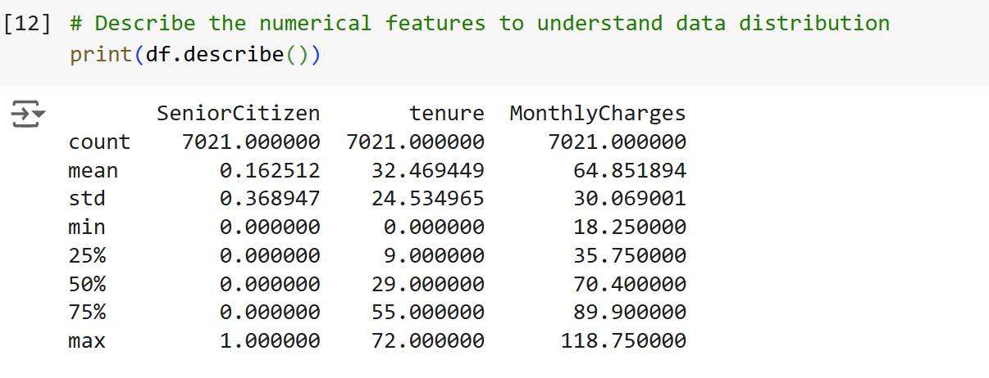
Statistical Analysis for Numerical Data
Mean- Calculating average value.
Standard Deviation shows the measures how spread out the numbers are from the mean.
Max provides the highest number in dataset.
Min provides the smallest number in the dataset

Slide 11
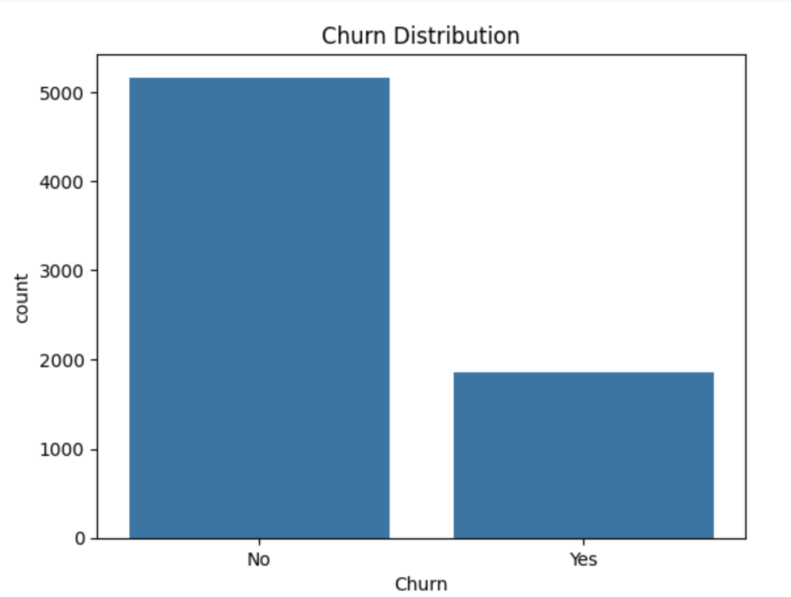
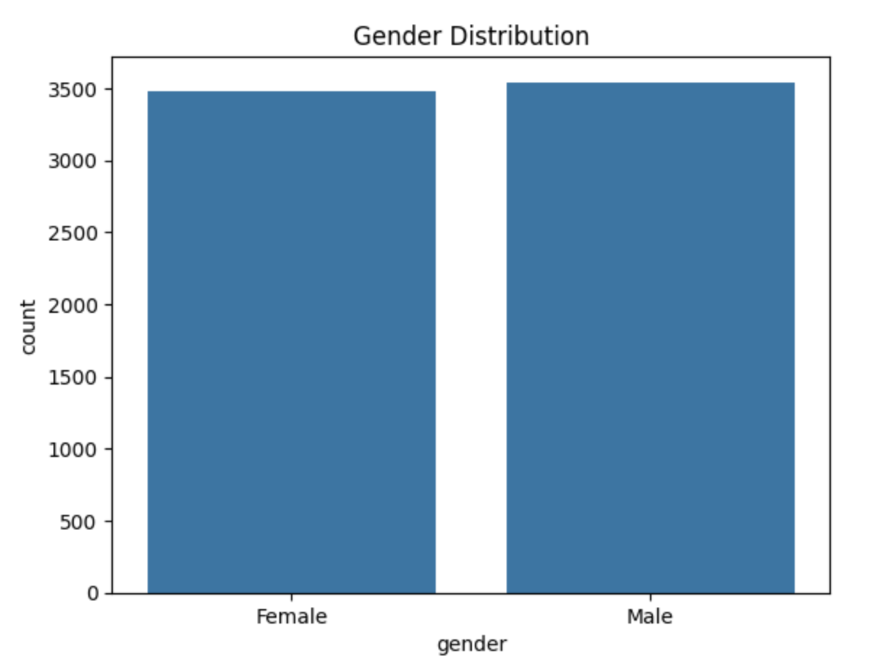
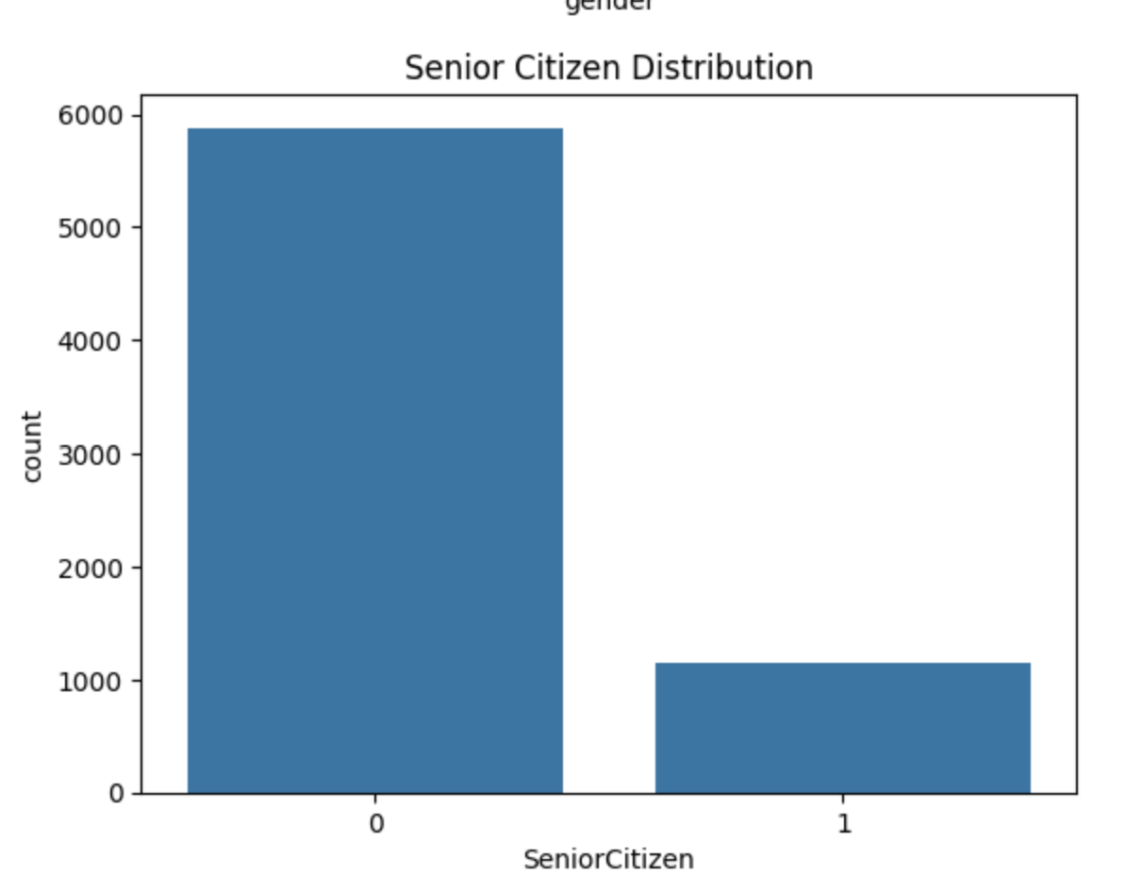
Visualizing Numerical Variables
Analysis: Countplot for feature distribution
A count plot shows how many times each category appears in your data.
These plots help to quickly see the distribution of categories in your data.

Slide 12
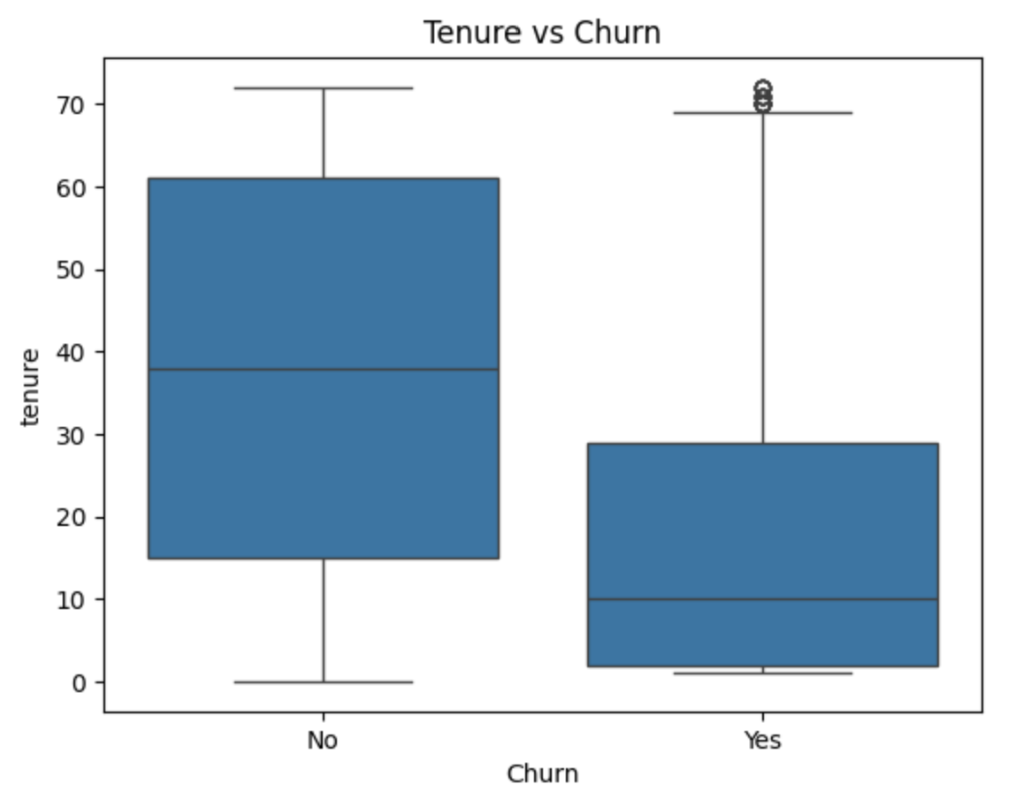
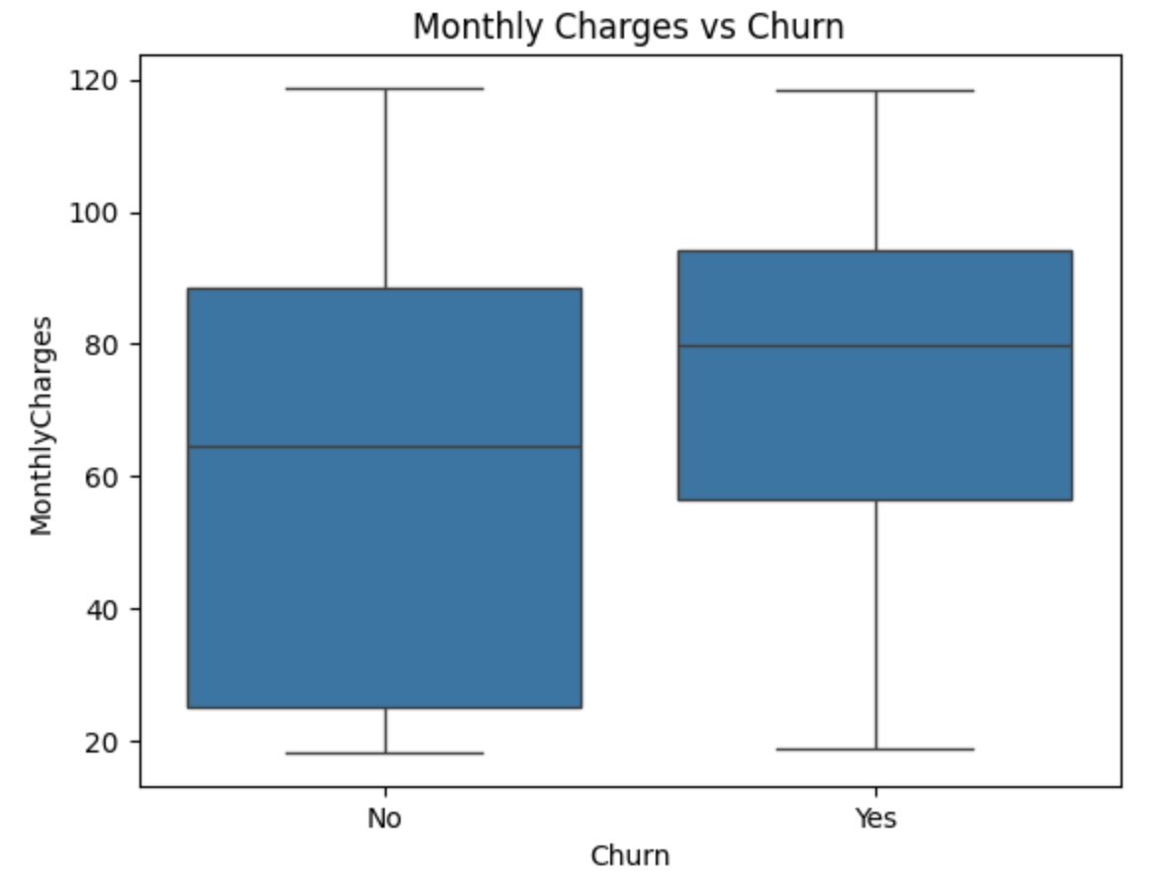
Visualizing Numerical Variables
Analysis: Box Plots for Numerical Variables
Box Plots helps to visualize the spread of data and detect potential outliers.
These box plots are created using the raw, uncleaned data.

Slide 13
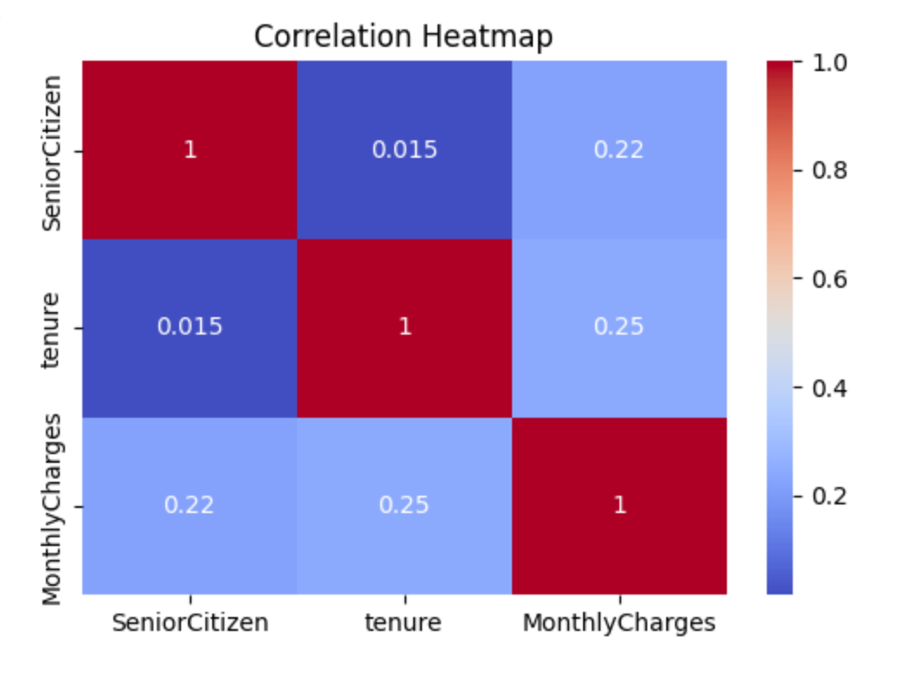
Correlation Analysis
Analysis : Heatmaps
Visualize the correlations between numerical variables to detect strong relationships.
A correlation heatmap shows how strongly related numeric variables are to each other in your dataset. It uses colors to represent the strength and direction of these relationships.

Slide 14
Logistic Regression
Logistic Regression is chosen because it is simple, interpretable, and works well for binary classification tasks like customer churn prediction. It provides both classification and probabilistic outputs, making it valuable for understanding and managing customer churn in telecom.

Slide 15
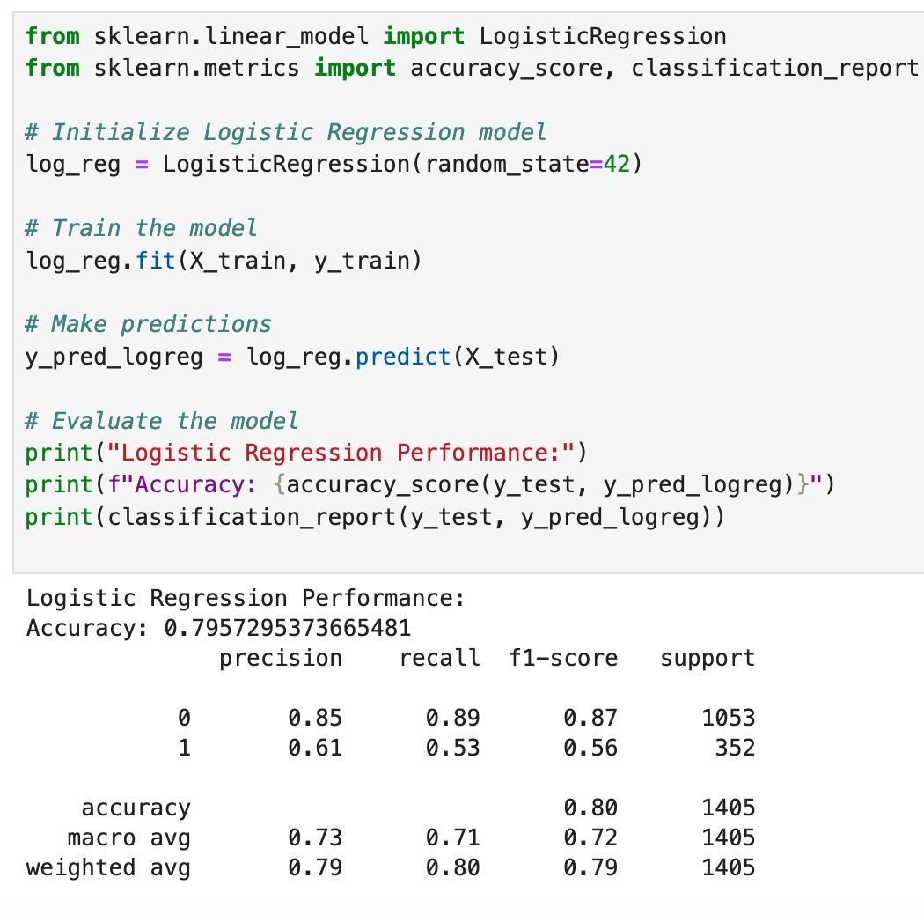
Logistic Regression
The Logistic Regression model achieved an accuracy of 81.55%, with precision of 0.86 and recall of 0.58 for churned customers
The model showed good performance in identifying non-churning customers, with a precision of 0.68 and recall of 0.90.

Slide 16
Decision Tree
Decision Tree is used to predict customer churn because it:
Provides easy-to-understand visualizations and insights.
Handles non-linear relationships between features and churn.
Identifies key factors influencing churn for targeted interventions.

Slide 17
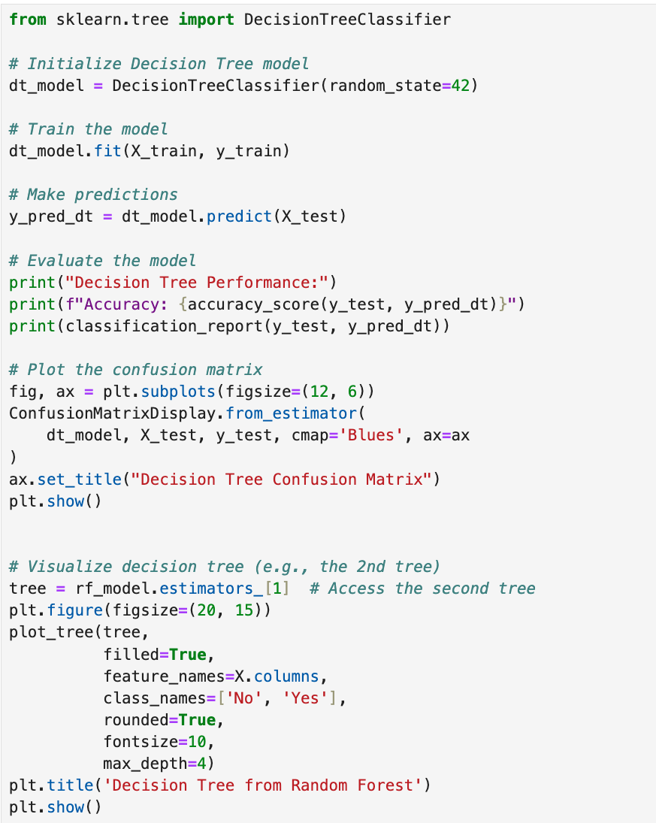
Decision Tree

Slide 18
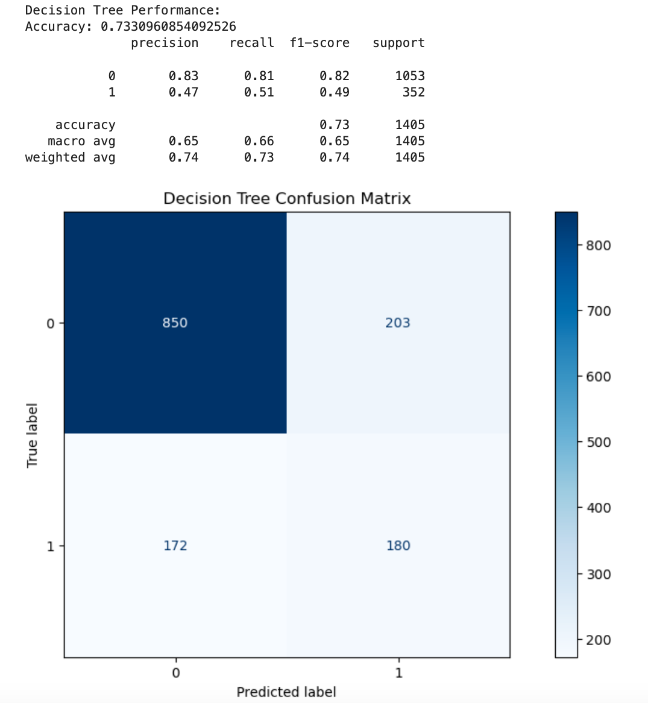
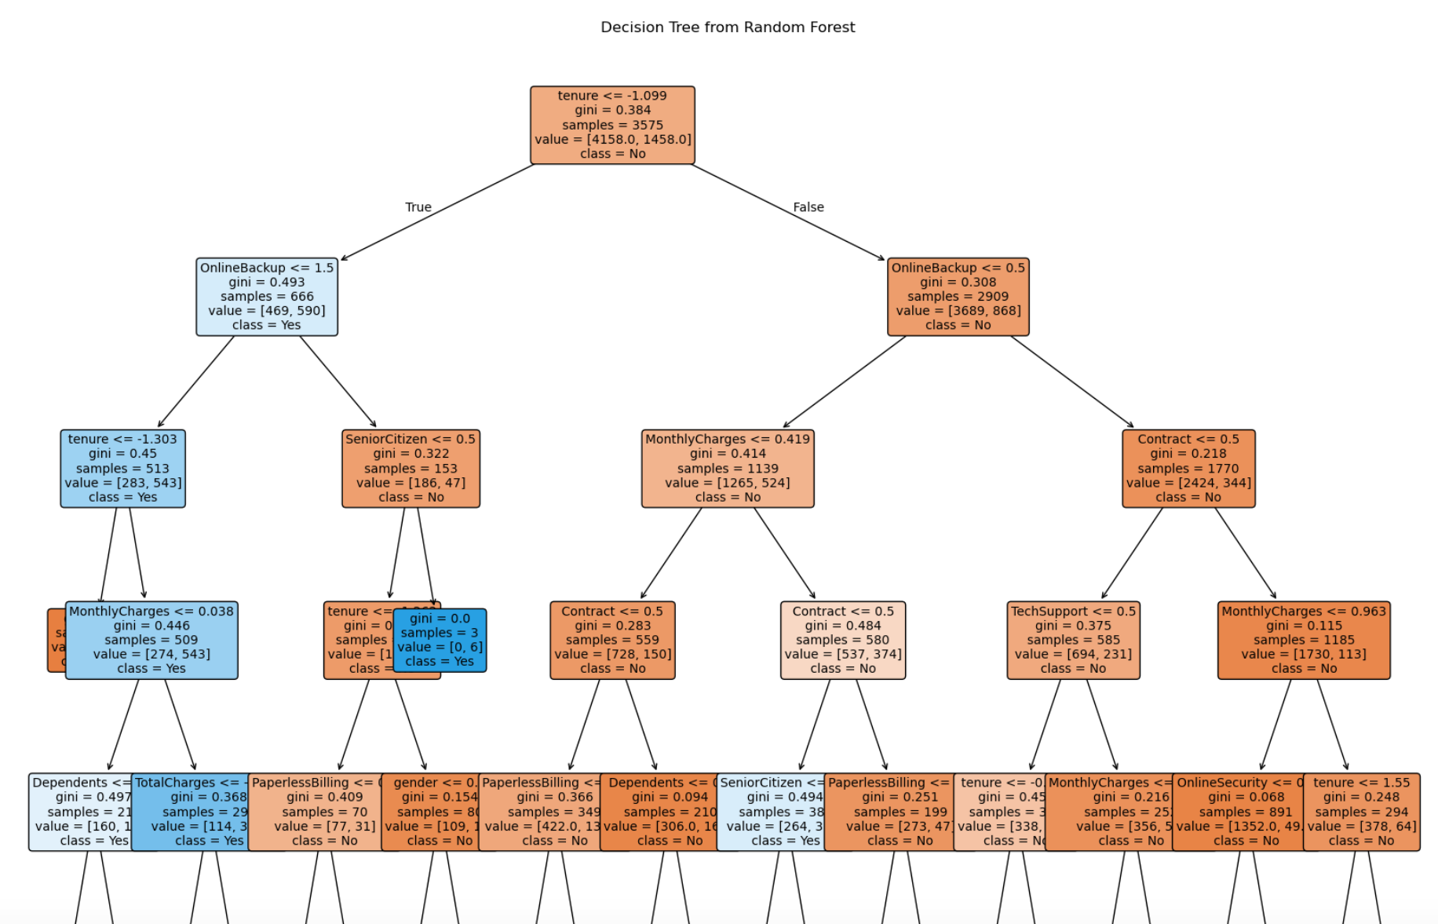
Decision Tree
The Decision Tree model achieved an accuracy of 73.2% for predicting customer churn.
Precision for predicting non-churn customers was 0.82, while recall for churn customers was 0.51.
The model effectively classified non-churn customers but struggled with identifying churn customers.

Slide 19
Random Forest
Improved Accuracy: Helps achieve better predictive accuracy for customer churn by leveraging multiple decision trees
Handles Complex Data: Effectively manages high-dimensional, noisy telecom data.
Feature Importance: Identifies key factors influencing churn, aiding in targeted interventions.

Slide 20
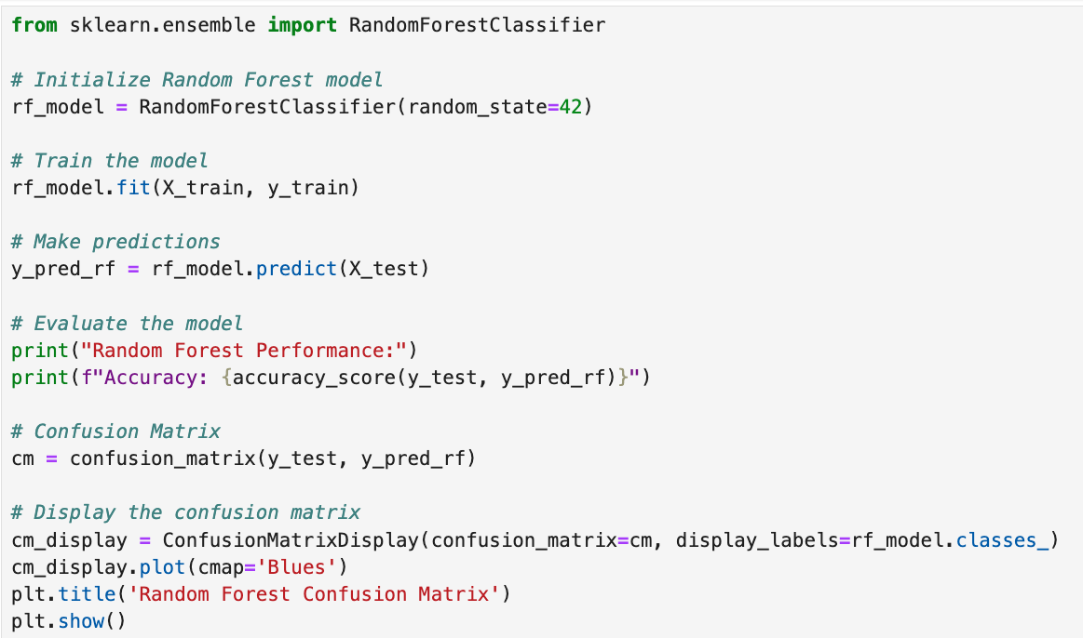
Random Forest

Slide 21
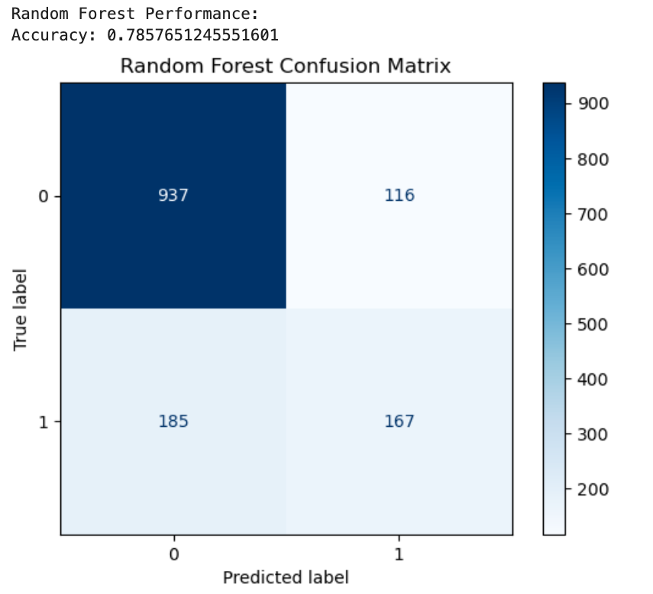
Random Forest
Random Forest Results:
Achieved an accuracy of 80.2% in predicting customer churn.
The model demonstrated strong performance, with high precision and recall for identifying churned customers.
Random Forest outperformed other models in handling complex patterns and feature interactions.

Slide 22
Model Performance Summary:
Conclusion based on the performance metrics of the three models evaluated — Logistic Regression, Decision Tree, and Random Forest:
Logistic Regression:
Accuracy: 81.55%
Precision (class 0): 86%
Precision (class 1): 68%
Recall (class 0): 90%
Recall (class 1): 58%
F1-Score (class 0): 88%
F1-Score (class 1): 62%
2. Decision Tree
Accuracy: 73.24%
Precision (class 0): 82%
Precision (class 1): 49%
Recall (class 0): 81%
Recall (class 1): 51%
F1-Score (class 0): 82%
F1-Score (class 1): 50%
3. Random Forest
Accuracy: 80.20%

Slide 23
Model Performance Summary:
Key Takeaways:
Logistic Regression performs relatively well with an overall accuracy of 81.55%. It has strong precision and recall for the majority class (class 0, "No Churn"), with excellent recall of 90%. The model struggles a bit more with the minority class (class 1, "Churn"), showing a lower recall and precision for churn cases (58% and 68% respectively). The F1 score for class 1 (churn) is 62%, indicating room for improvement.
Decision Trees provide a slightly lower accuracy (73.24%) than Logistic Regression. Precision for the majority class (class 0) is quite good (82%), but the performance drops significantly for the minority class (class 1), with precision of only 49%. Recall for class 1 (churn) is relatively low at 51%, indicating that the Decision Tree misses a substantial number of churn cases. Overall, the Decision Tree struggles more with imbalanced data, especially predicting the minority class (churn).
Random Forest has a strong overall accuracy of 80.20%, which is close to that of Logistic Regression. Although the detailed classification metrics (precision, recall, and F1-score) for Random Forest were not provided, we can expect it to perform better than a single Decision Tree, given that it averages multiple decision trees, reducing overfitting. Random Forest should generally handle imbalanced classes better than Decision Trees due to its ensemble approach, which helps in improving overall prediction accuracy for both classes.

Slide 24
Conclusion
Best Overall Performance:
Logistic Regression achieves the highest accuracy (81.55%) and has better precision and recall for the majority class (class 0). However, it struggles to predict the minority class (churn, class 1), especially with recall.
Random Forest, while slightly behind Logistic Regression in accuracy (80.20%), might offer better balanced performance, especially in handling the minority class (churn), since it combines the predictions of multiple trees.
Decision Tree performs the worst in terms of accuracy (73.24%) and precision/recall for the minority class (churn). It is prone to overfitting and may struggle with imbalanced data.
Recommendations:
Logistic Regression might be a good choice if you prioritize a simpler model and high recall for the majority class, but improvements could be made for predicting churn cases (class 1).
Random Forest appears to be the most robust model in this case, potentially outperforming Logistic Regression for balanced performance, particularly if fine-tuned for better handling of churn (class 1).
Decision Tree should be avoided in this case due to its relatively poor performance and its tendency to miss predicting churn cases effectively.

Slide 25
Conclusion
This project comprehensively analyzed customer churn in the telecom industry using the Kaggle dataset, which included a variety of customer attributes such as demographics, service usage, payment methods, and contract types. Through Exploratory Data Analysis (EDA), we identified key features that influence customer churn, such as contract type, payment method, tenure, and the presence of services like online security, tech support, and streaming options. The relationships observed in the data highlighted that customers with month-to-month contracts, shorter tenure, and those using paper billing were more likely to churn.
Furthermore, machine learning models, including Logistic Regression, Decision Trees, and Random Forests, were applied to predict customer churn. Among the models tested, Logistic Regression performed the best in terms of accuracy (81.5%), precision, and recall, though Random Forest also demonstrated strong performance with an accuracy of 80.2%. Decision Trees, while interpretable, showed the weakest performance, with an accuracy of approximately 73%. These models demonstrated the ability to identify high-risk customers effectively, with Random Forest and Logistic Regression providing actionable insights for customer retention strategies.
The results suggest that telecom companies can improve customer retention by focusing on high-impact features such as contract type, customer service offerings, and billing methods. By utilizing predictive models like Logistic Regression and Random Forests, businesses can proactively identify at-risk customers and implement targeted retention efforts, such as offering personalized plans, discounts, or enhanced customer service for those with a higher likelihood of churn.
In conclusion, this study provides both a deeper understanding of customer behavior and practical tools for predicting churn, which can be used to guide marketing strategies, customer service improvements, and business decisions. These findings have significant implications for resource allocation, cost reduction, and the building more effective customer loyalty programs in the telecom sector.

Slide 26
References
https://www.kaggle.com/datasets/kamilpytlak/personal-key-indicators-of-heart-disease
https://pandas.pydata.org/docs/
https://matplotlib.org/stable/index.html

Slide 27
Github Repository Code
Github Repository Link: https://github.com/SayaliSawant0101/Python-Final-Project

Slide 28
Thank You!
Team members:
Arjun Mahajan
Sayali Sawant
Pranjali Chandgadkar
Puneeth Chowdhary

